Slide 1
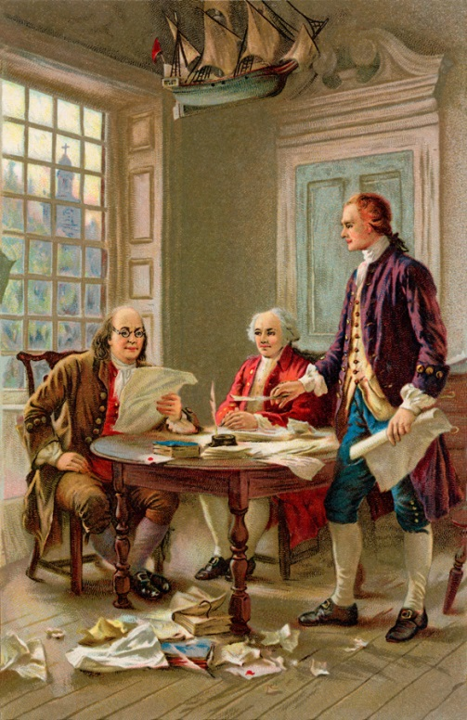


Assessment of General Education
Tips and Techniques
Developed by OCU Office of Assessment
Coordinator: Dr. Jo Lynn Autry Digranes

Slide 2
Assessment of Student Learning
The systematic collection of information about student learning, using the time, knowledge, expertise, and resources available, in order to inform decisions about how to improve learning.
Walvoord, B. E. (2004). Assessment clear and simple A practical guide for institutions, departments, and general education. San Francisco, CA: Jossey-bass A Wiley Imprint.

Slide 3
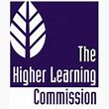
HLC Statement on Student Learning, Assessment, and Accreditation
Fundamental Questions for Conversations on Student Learning
Six fundamental questions serve as prompts for conversations about student learning and the role of assessment in affirming and improving that learning:
How are your stated student learning outcomes appropriate to your mission, programs, degrees, and students?
What evidence do you have that students achieve your stated learning outcomes?
In what ways do you analyze and use evidence of student learning?
How do you ensure shared responsibility for student learning and for assessment of student learning?
How do you evaluate and improve the effectiveness of your efforts to assess and improve student learning?
In what ways do you inform the public and other stakeholders about what students are learning---and how well?
Higher Learning Commission. (2007) Statement on Student Learning, Assessment and Accreditation. HLC Website: http://ncahlc.org/Information-for-Institutions/publications.html

Slide 4

Setting Goals
The institution’s statements of learning outcomes clearly articulate what students should be able to do, achieve, demonstrate, or know upon the completion of each undergraduate degree.
The outcomes reflect appropriate higher education goals and are stated in a way that allows levels of achievement to be assessed against an externally informed or benchmarked level of achievement or assessed and compared with those of similar institutions.
New Leadership Alliance for Student Learning and Accountability. (2012). Committing to quality Guidelines for assessment and accountability in higher education. Washington, D.C.: New Leadership Alliance for Student Learning and Accountability.

Slide 5
Setting Goals
Institutional practices, such as program review, are in place to ensure that curricular and co-curricular goals are aligned with intended learning outcomes.
The institution and its major academic and co-curricular programs can identify places in the curriculum or co-curriculum where students encounter or are expected or required to achieve the stated outcomes.
Learning outcome statements are presented in prominent locations and in ways that are easily understood by interested audiences.
New Leadership Alliance for Student Learning and Accountability. (2012). Committing to quality Guidelines for assessment and accountability in higher education. Washington, D.C.: New Leadership Alliance for Student Learning and Accountability.

Slide 6

Evidence of Gathering Student Data
Policies and procedures are in place that describe when, how, and how frequently learning outcomes will be assessed.
Assessment processes are ongoing, sustainable, and integrated into the work of faculty, administrators, and staff.
Evidence includes results that can be assessed against an externally informed or benchmarked level of achievement or compared with those of other institutions and programs.
New Leadership Alliance for Student Learning and Accountability. (2012). Committing to quality Guidelines for assessment and accountability in higher education. Washington, D.C.: New Leadership Alliance for Student Learning and Accountability.

Slide 7
Evidence of Gathering Student Data
Evidence also includes assessments of levels of engagement in academically challenging work and active learning practices.
Results can be used to examine differences in performance among significant subgroups of students, such as minority group, first-generation, and non-traditional-age students.
New Leadership Alliance for Student Learning and Accountability. (2012). Committing to quality Guidelines for assessment and accountability in higher education. Washington, D.C.: New Leadership Alliance for Student Learning and Accountability.

Slide 8
General Education Assessment
The process of assessing general education is not a means to its own end; rather, it is a way to systematically engaged in daily critical inquire about what works well and what needs to be improved.
Maki, P.L. (2004). Assessing for learning: Building a sustainable commitment across the institution. Sterling, VA: Stylus.

Slide 9
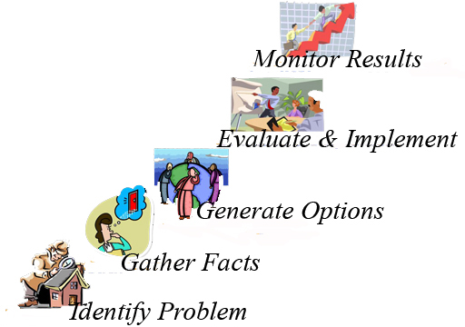
Assessment Steps
Develop learner outcomes.
Check for alignment between the curriculum and the outcomes.
Develop an assessment plan.
Collect assessment data.
Use results to improve the program.
Routinely examine the assessment process.
Allen, M. J. (2006). Assessing general education programs. San Francisco, CA: Jossey-Bass, A Wiley Imprint.

Slide 10
Steps in Developing and Sustaining Assessment of General Education
Determine the purpose of general education.
Articulate goals and outcomes for general education.
Design or refine the delivery of learning outcomes.
Align learning outcomes to the delivery of the general education (e.g., connect the learning to teaching and course and curriculum design).
Bresciani, M. J. (2007) Assessing student learning in general education Good practice case studies. Bolton, MA: Anker Publishing Company, Inc.

Slide 11
Steps in Developing and Sustaining Assessment of General Education
Align education outcomes with the discipline outcomes, cocurricular outcomes, and overarching student learning principles, as applicable.
Identify the means to evaluate learning outcomes (both direct and indirect methods) and do so in a manner that will help inform decisions or recommendations to improve learning.
Bresciani, M. J. (2007) Assessing student learning in general education Good practice case studies. Bolton, MA: Anker Publishing Company, Inc.

Slide 12

Steps in Developing and Sustaining Assessment of General Education
Gather, analyze, and interpret results in a manner that will lead to decisions, and recommendations for improvement at all levels.
Discuss the recommendations for improving student learning in a collegial manner and with regard to the resources that will be needed to improve student learning.
Bresciani, M. J. (2007) Assessing student learning in general education Good practice case studies. Bolton, MA: Anker Publishing Company, Inc.

Slide 13

Steps in Developing and Sustaining Assessment of General Education
Report the results in a manner that will invite feedback from those involved in the learning process, including students and co-curricular professionals.
Align the evaluation processes of general education with those of the disciplines and professional accreditors, where appropriate.
Bresciani, M. J. (2007) Assessing student learning in general education Good practice case studies. Bolton, MA: Anker Publishing Company, Inc.

Slide 14

Steps in Developing and Sustaining Assessment of General Education
Build consensus at each step.
Explore additional opportunities to collaborate for improving student learning in general education.
Have conversations about removing barriers to improving student learning.
Bresciani, M. J. (2007) Assessing student learning in general education Good practice case studies. Bolton, MA: Anker Publishing Company, Inc.

Slide 15
General Education Models
A distribution model that guarantees breadth in the undergraduate curriculum
A specially created set of core courses that integrate the liberal arts
A specially created set of courses that emphasize processes and individual student growth
Allen, M. J. (2006). Assessing general education programs, San Francisco, CA: Jossey-Bass, A Wiley Imprint.

Slide 16
Examples of Goal Levels
Institutional: Students will communicate effectively orally and in writing.
General Education Curriculum: Students will write essays in which they select and defend a position on a debatable issue, analyze a text, propose research, or define a problem and suggest solutions.
Composition Course: Students will write a 5 to 7 page argumentative essay in which they select and defend a position on a debatable issue, support their position with evidence from their readings, and address counterarguments.
Allen, M. J. (2006). Assessing general education programs. San Francisco, CA: Jossey-Bass, A Wiley Imprint.

Slide 17

Direct and Indirect Assessment
Direct assessment involves an analysis of products or behaviors that demonstrate the extent of students’ mastery of learning outcomes.
Indirect assessment involves people’s opinions, and these opinions can richly supplement what is learned in direct assessment studies.
Allen, M. J. (2006). Assessing general education programs. San Francisco, CA: Jossey-Bass, A Wiley Imprint.

Slide 18
Direct Assessment Examples
Standardized tests
Locally developed tests
Embedded assignments and activities
Portfolios
Allen, M. J. (2006). Assessing general education programs. San Francisco, CA: Jossey-Bass, A Wiley Imprint.

Slide 19
More Direct Assessment Examples
Final Projects – such as senior thesis, undergraduate research project, senior art show or music recital
Capstone Experiences – such as student teaching, internship, cooperative educational experience
Middaugh, M.F. (2010). Planning and assessment in higher education. San Francisco, CA: Jossey-Bass A Wiley Imprint.

Slide 20

Direct Assessments
Strengths and Limitations
Standardized Tests
  Strengths
    Professionally developed
    Established validity and reliability
    Typically provide multiple comparison groups
  Limitations
    May not align with institution’s learning outcomes or curriculum
    May only test at limited depth of processing
    Students may not be motivated
Allen, M. J. (2006). Assessing general education programs. San Francisco, CA: Jossey-Bass, A Wiley Imprint.

Slide 21

Direct Assessments
Strengths and Limitations
Locally Developed Tests
  Strengths
    Align precisely with campus general education outcomes
    Can include authentic assessment, performance assessment, and questions that reveal depth of understanding
  Limitations
    Unknown validity and reliability
    Lack norm groups for comparisons
    Faculty time to develop and to score
Allen, M. J. (2006). Assessing general education programs. San Francisco, CA: Jossey-Bass, A Wiley Imprint.

Slide 22

Direct Assessments
Strengths and Limitations
Embedded Assessment
  Strengths
    May be based on a variety of learning activities, such as homework, oral presentations, writing assignments
    Both teachers and students are fully engaged
    Data collection is unobtrusive and requires little or no additional faculty or student time
  Limitations
    Embedding same assessment in multiple courses requires coordination and faculty agreement
    Validity and reliability not known
Allen, M. J. (2006). Assessing general education programs. San Francisco, CA: Jossey-Bass, A Wiley Imprint.

Slide 23

Direct Assessments
Strengths and Limitations
Portfolios (Showcase and Developmental)
  Strengths
    Requires student to take responsibility for work and to reflect upon the work
    Developmental portfolios can be integrated into advising
  Limitations
    Effort in preparing portfolio assignment
    Effort and resources needed in storing portfolios
    Effort in assessing portfolios
Allen, M. J. (2006). Assessing general education programs. San Francisco, CA: Jossey-Bass, A Wiley Imprint.

Slide 24
Direct Assessments
Strengths and Limitations
Final Projects
  Strengths
    Good for measuring mastery of general education skills
    Good for general content and skills with a specific discipline
    Used extensively in fine arts disciplines
  Limitations
    Can be time intensive
Middaugh, M.F. (2010). Planning and assessment in higher education. San Francisco, CA: Jossey-Bass A Wiley Imprint.

Slide 25
Direct Assessments
Strengths and Limitations
Capstone Experiences
  Strengths
    Commonly utilized in professional disciplines
    Assist in addressing employer criticisms that graduates do not have requisite skills and knowledge for jobs
    Feedback from experience sites can be very helpful for curriculum
  Limitations
    Appropriate placements can be difficult to locate
    Ensuring quality feedback from placement site may be difficult
Middaugh, M.F. (2010). Planning and assessment in higher education. San Francisco, CA: Jossey-Bass A Wiley Imprint.

Slide 26
Indirect Assessment Examples
Surveys
Interviews
Focus Groups
Allen, M. J. (2006). Assessing general education programs. San Francisco, CA: Jossey-Bass, A Wiley Imprint.

Slide 27

Indirect Assessments
Strengths and Limitations
Surveys
  Strengths
    Can reach many respondents asynchronously and at a distance
    Can complement results from direct assessments
    There are many standardized surveys, such as NSSE, that have validity and reliability and can compare to norm groups
    Often easy to score
  Limitations
    May have low response rate and low motivation by respondents
    What people say or do may be inconsistent with what they actually do or know.
Allen, M. J. (2006). Assessing general education programs. San Francisco, CA: Jossey-Bass, A Wiley Imprint.

Slide 28

Indirect Assessment
Strengths and Limitations
Interviews
  Strengths
    Flexible in format
    Can include both close-ended and open-ended questions
    May provide more detail
  Limitations
    Scheduling and time involved
    Requires interpersonal skills and non-biased view for interviewer
Allen, M. J. (2006). Assessing general education programs. San Francisco, CA: Jossey-Bass, A Wiley Imprint.

Slide 29
Indirect Assessment
Strengths and Limitations
Focus Groups
  Strengths
    May uncover more in-depth responses
    Allow checking for consensus
  Limitations
    Best for addressing a few issues
    Required interpersonal skills for a non-biased interviewer
    Recruiting and scheduling can be difficult
    Analysis of responses may be easily visible, but may require further skilled interpretation
Allen, M. J. (2006). Assessing general education programs. San Francisco, CA: Jossey-Bass, A Wiley Imprint.

Slide 30
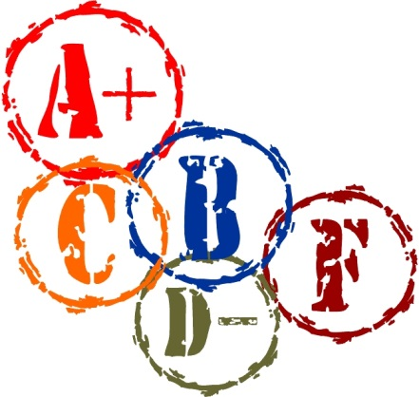
Building Assessment on the Grading Process
Grading is a “direct” measure of learning because there is direct evaluation of student work.
Grading is already embedded within the culture of higher education.
The grade alone is not sufficient, but must include explicit performance and criteria.
Walvoord, B. E. (2004). Assessment clear and simple A practical guide for institutions, departments, and general education. San Francisco, CA: Jossey-bass A Wiley Imprint.

Slide 31
Building Assessment on the Grading Process
A direct measure requires:
  A student performance such as an exam or project
  A set of criteria by which to evaluate the performance
  Analysis and interpretation of the results
  A feedback loop into department, gen ed, and/or institutional decision-making processes
Walvoord, B. E. (2004). Assessment clear and simple A practical guide for institutions, departments, and general education. San Francisco, CA: Jossey-bass A Wiley Imprint.

Slide 32

Making the Grading Process Useful for Program Assessment
Ensure that the classroom exam or assignment actually measures the learning goals.
State explicitly in writing the criteria for evaluating student work in sufficient detail to identify students’ strengths and weaknesses.
Develop systematic ways of feeding information about student strengths and weaknesses back to decision makers at the departmental, general education, and institutional levels and using that information for programmatic improvement.
Walvoord, B. E. (2004). Assessment clear and simple A practical guide for institutions, departments, and general education. San Francisco, CA: Jossey-bass A Wiley Imprint.

Slide 33
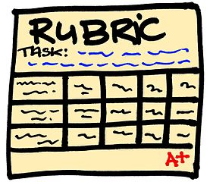
The Rubric
A rubric articulates in writing the various criteria and standards that a faculty member uses to evaluate student work.
Walvoord, B. E. (2004). Assessment clear and simple A practical guide for institutions, departments, and general education. San Francisco, CA: Jossey-bass A Wiley Imprint.

Slide 34
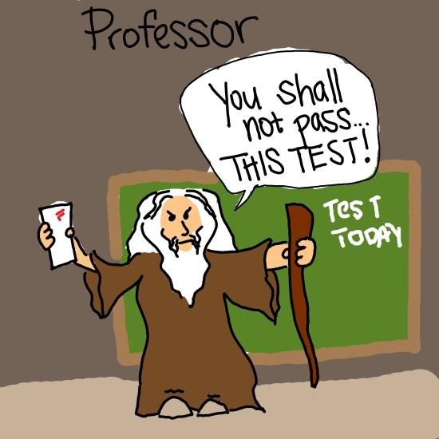
The Rubric
A rubric can be constructed by:
  The faculty member
  A group of faculty (or teaching assistants) all teaching the same course
  A department or general education committee that is establishing criteria for evaluating samples of students work or that wants all faculty teaching a certain course to use the same rubric.
Walvoord, B. E. (2004). Assessment clear and simple A practical guide for institutions, departments, and general education. San Francisco, CA: Jossey-bass A Wiley Imprint.

Slide 35

The Rubric
The rubric can also be constructed by other groups, such as:
  College faculty/departments working together within a local area or nationally
  Content experts
  Combinations of the above, such as the Association of American Colleges and Universities VALUE RUBRIC project
  http://www.aacu.org/value

Slide 36
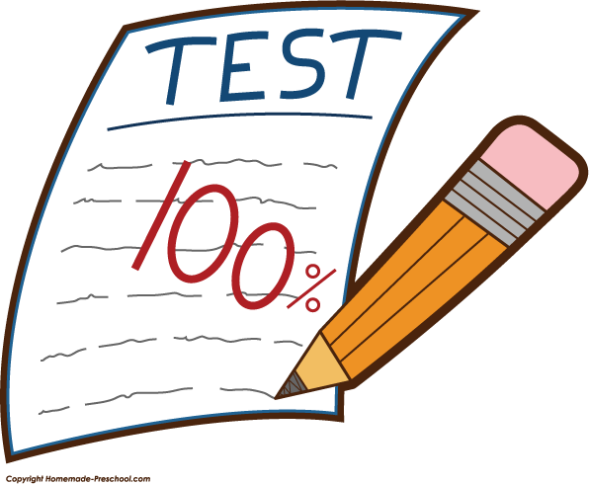
The Rubric
Steps in Construction
Choose a test or assignment that tests what you want to evaluate. Make clear your objectives for the assignment.
Collect any grading criteria you have handed out to students in the past as well as sample student papers with your comments. They assist with the following steps.
Walvoord, B. E. (2004). Assessment clear and simple A practical guide for institutions, departments, and general education. San Francisco, CA: Jossey-bass A Wiley Imprint.

Slide 37
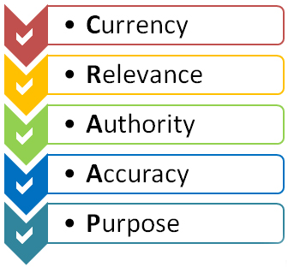
The Rubric
Steps in Construction
Identify the “traits” that will count in the evaluation. These are nouns or noun phrases without any implication of judgment: for example, “thesis,” “eye contact with client,” “costume design,” or “control of variables.”

Slide 38
The Rubric
Steps in Construction
For each trait, construct a scale describing each level of student performance from the least skillful to the most skillful. You may use three, four, or five levels, depending on the needs for finer distinction. The scales use descriptive statements. An example:
  “A thesis that receives a score of “5” is limited enough for the writer to support within the scope of the essay and is clear to the reader; it intelligently enters the dialogue of the discipline as reflected in the students’ sources, and it does so at a level that shows synthesis and original thought; it neither exactly repeats any of the student’s sources nor states the obvious.”
Walvoord, B. E. (2004). Assessment clear and simple A practical guide for institutions, departments, and general education. San Francisco, CA: Jossey-bass A Wiley Imprint.

Slide 39
The Rubric
Steps in Construction
Try out the scale with actual student work. Revise the scale as needed.
Have a colleague in your discipline use your scale to evaluate actual student work. Revise the scale as needed.
Walvoord, B. E. (2004). Assessment clear and simple A practical guide for institutions, departments, and general education. San Francisco, CA: Jossey-bass A Wiley Imprint.

Slide 40
AACU VALUE Rubrics
The project “Valid Assessment of Learning in Undergraduate Education (VALUE) began in 2007, initiated by the American Association of Colleges and Universities (AACU). The project focused upon development of rubrics, with an initial release in 2009. The rubrics were to be designed to link to the AACU Liberal Education and America’s Promise (LEAP) fifteen areas of “Essential Learning Outcomes.”

Slide 41
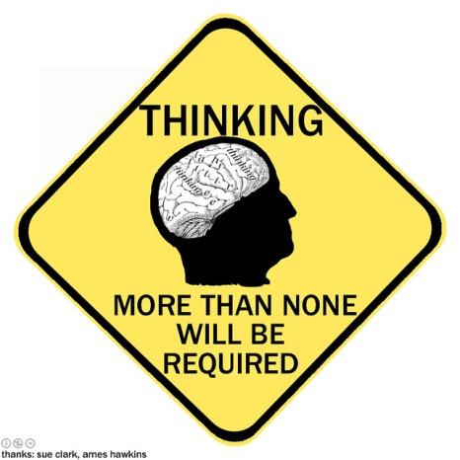
AACU Essential Learning Outcomes
  Civic engagement
  Creative thinking
  Critical thinking
  Ethical reasoning
  Foundations and skills for lifelong learning
  Information literacy
  Inquiry and analysis
  Integrative and applied learning
Intercultural knowledge and competence
Oral communication
Problem solving
Quantitative literacy
Reading
Teamwork
Written communication

Slide 42
AACU VALUE Rubrics
Developed by teams of faculty and other academic and student affairs professionals from all sectors of higher education across the United States
The VALUE Rubrics were initially tested at over 100 colleges and universities.
Since made public in 2010, they have been downloaded and used at over 4,000 discrete institutions in the U.S., Australia, Japan, Hong Kong, Dubai, and Korea.

Slide 43
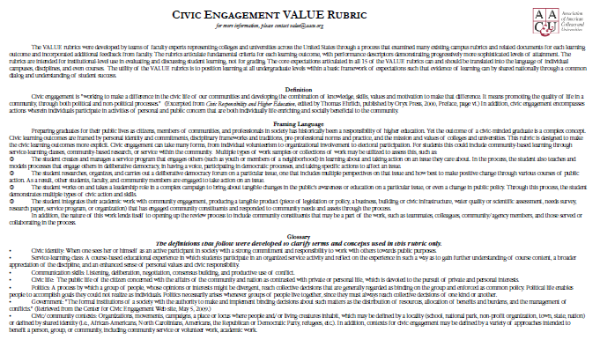
Examples

Slide 44
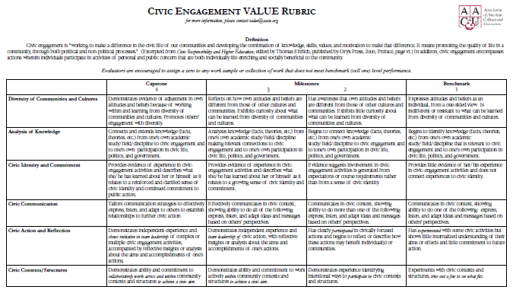
Examples

Slide 45
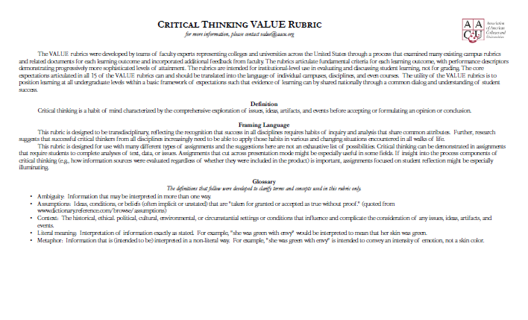
Examples

Slide 46
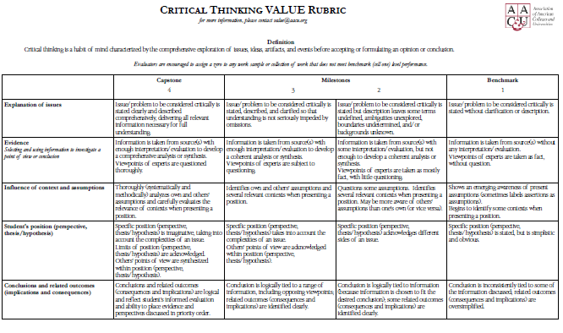
Examples

Slide 47
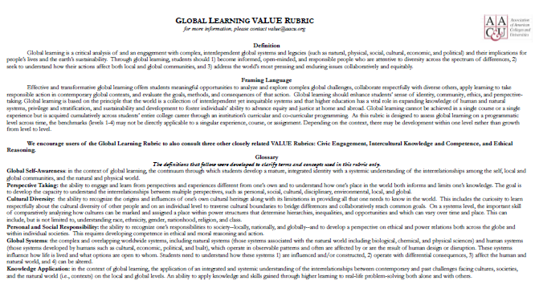
Examples

Slide 48
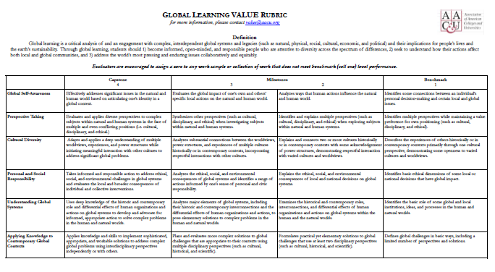
Examples

Slide 49

Timing Assessment
Ideally, assessment is built into strategic planning for an institution or department and is a component of any new program as it is being conceived.
Because effective assessment requires the use of multiple methods, it is not usually resource- efficient to implement every method right away or every year. A comprehensive assessment plan will include a schedule for implementing each data-gathering method at least once over a period of three (03) to five (05) years.
Banta, T.W., Jones, E.A., & Black, K.E. (2009). Designing effective assessment Principles and profiles of good practice. San Francisco, CA: Jossey-Bass A Wiley Imprint

Slide 50
Questions?

